Slide 1

Microsoft Power BI is a collection of -
software services,
apps, and
connectors
that work together to turn your unrelated sources of data into coherent, visually immersive, and interactive insights.

Slide 2
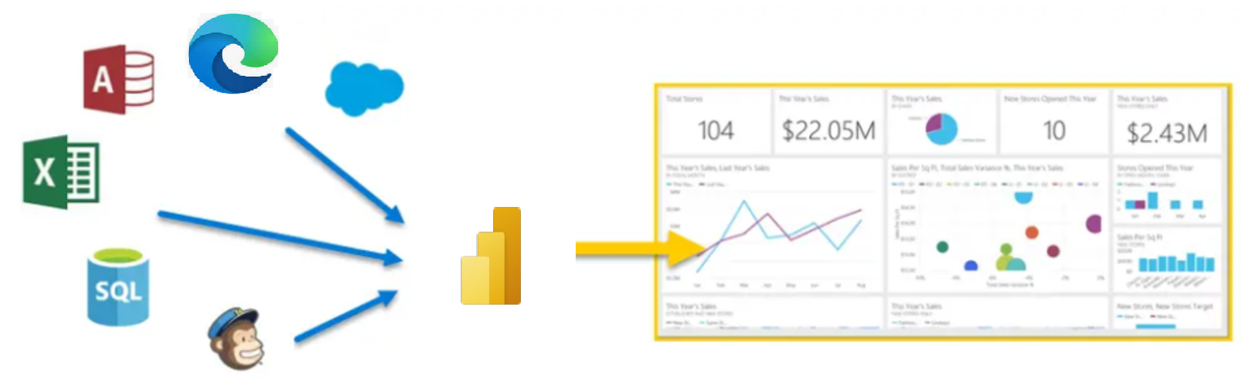
What is Power BI?
Microsoft Power BI is a collection of software services, apps, and connectors that work together to turn your unrelated sources of data into coherent, visually immersive, and interactive insights.

Slide 3
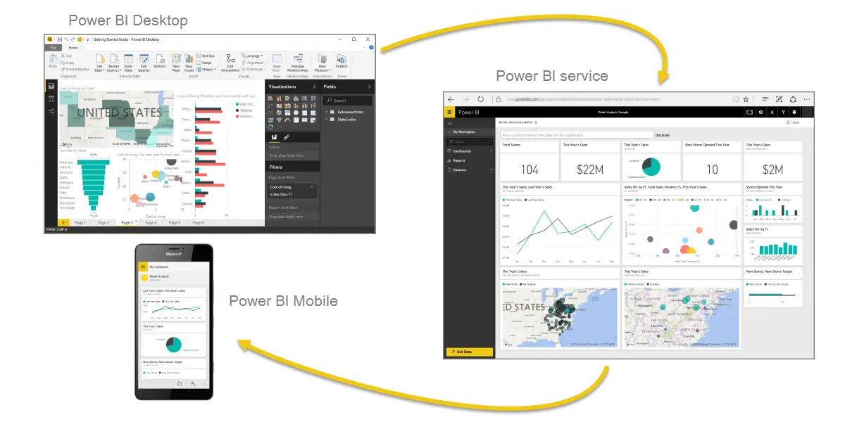
Parts of Power BI:
There are three major components of Power BI ecosystem -
Power BI Desktop: Microsoft Windows desktop application
Power BI service: online SaaS (Software as a Service) service
Power BI Mobile apps: that are available on any device, with native mobile BI apps for Windows, iOS, and Android.
These three elements—
Desktop,
service, and
Mobile apps—
are designed to let people create, share, and consume business insights in the way that serves them, or their role, most effectively.

Slide 4
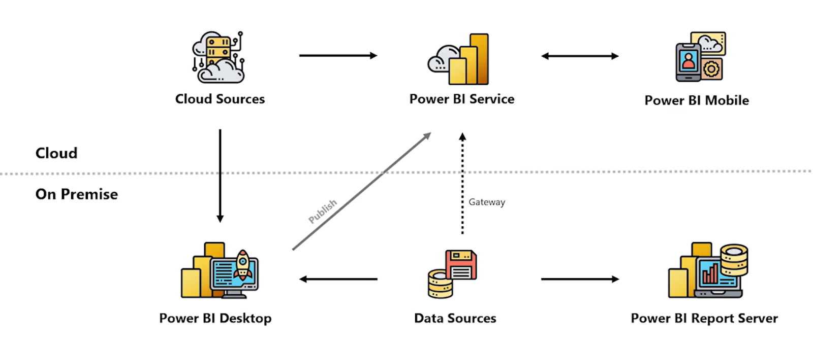
Power BI High Level Architecture:
Current Position of Power BI in market

Slide 5
Power BI High Level Architecture:
Current Position of Power BI in market

Slide 6
Power BI High Level Architecture:
Current Position of Power BI in market

Slide 7
Power BI High Level Architecture:
Current Position of Power BI in market

Slide 8
Power BI High Level Architecture:
Current Position of Power BI in market

Slide 9
Power BI Accounts and Pricing

Slide 10


Installing Power BI Desktop
Two ways to download Power BI desktop:
https://powerbi.microsoft.com
System requirements:
OS: Windows 8.1 or later
RAM: At least 2 GB of available memory (RAM), 4GB is recommended
System Type: x32 or x64
Browser: Microsoft Edge Browser

Slide 11
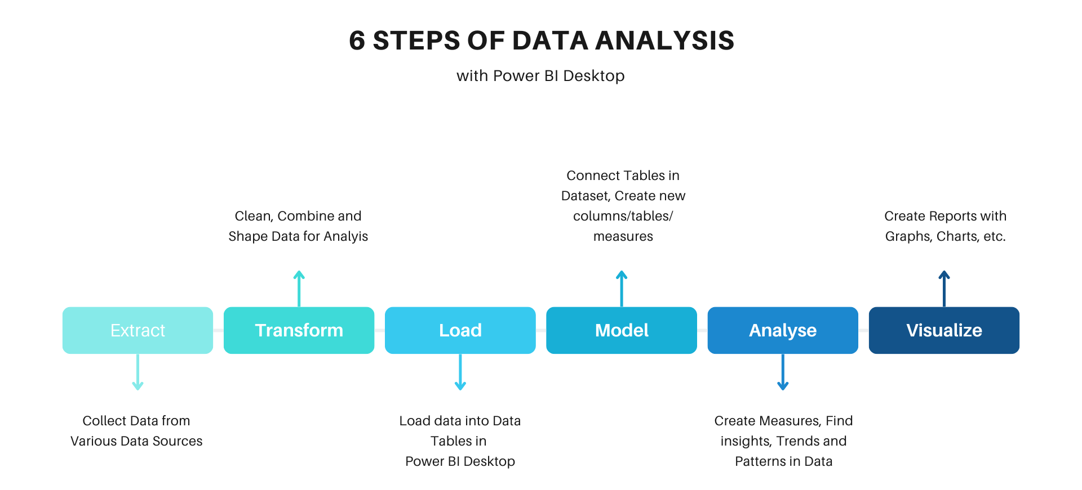
Data Analysis with Power BI

Slide 12
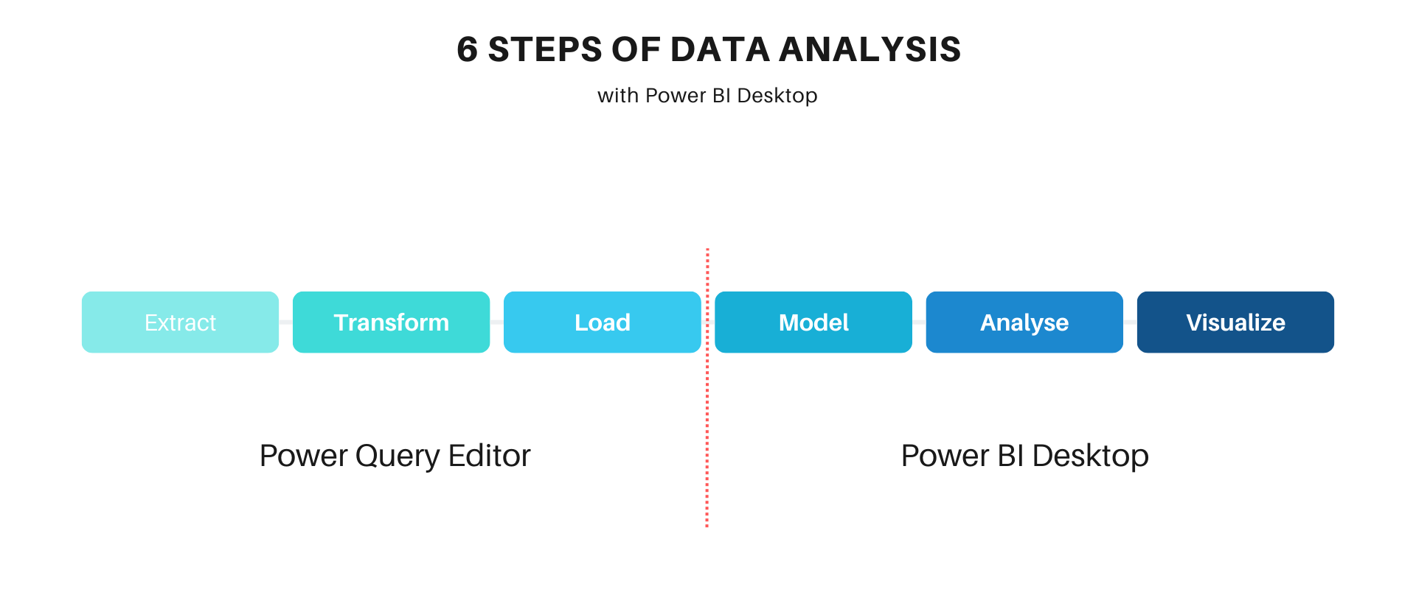
Data Analysis with Power BI

Slide 13
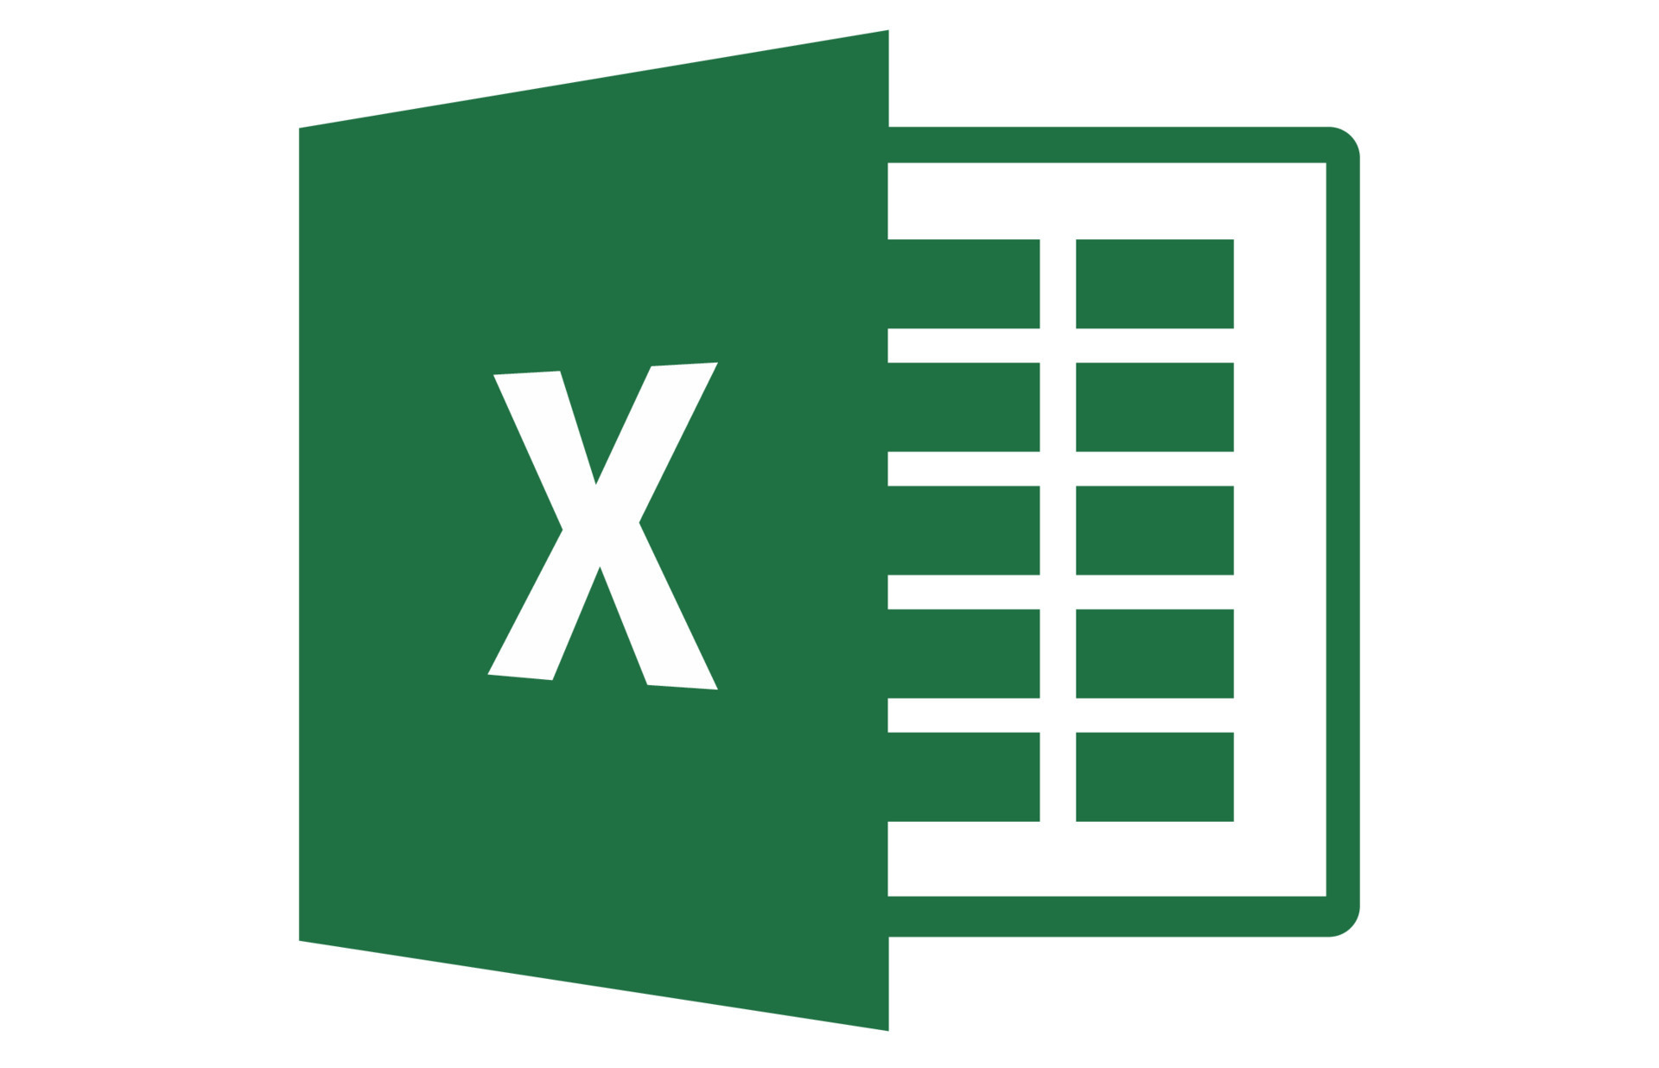

Excel Vs Power BI
BI Tool Made to handle big data. Interactive Visualizations Powerful collaboration With the connection between Power BI Desktop and Power BI Pro, you can easily collaborate on projects instantly, very efficiently, and also very convenient.
Excel
Spreadsheet Tool Have data size limitations Basic Visualization Limited Collaboration Small data, Quick Calculations, some quick charts, and some quick tables all these things in a single tool

Slide 14
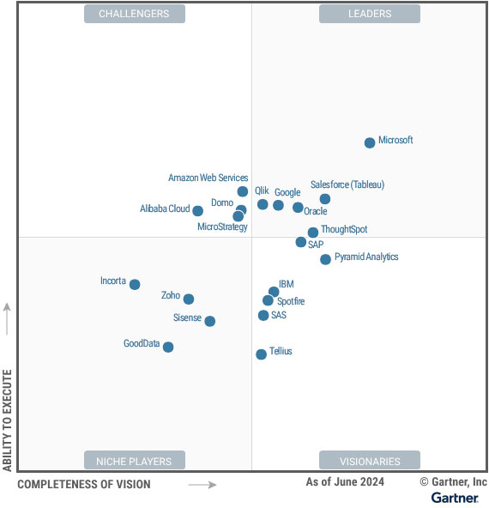
Microsoft has been ranked number one in the Gartner Magic Quadrant 2024 report for analytics and business intelligence platforms.
Source: *2023 Gartner Magic Quadrant for Analytics and Business Intelligence Platforms

Slide 15









Companies in India using Power BI tool:

Slide 16



Self-Service BI (SSBI) App
Drag-n-Drop functionality
Interactive Visuals/Dashboards

Slide 17



Automated Insights
Natural language query
Data science integration

Slide 18
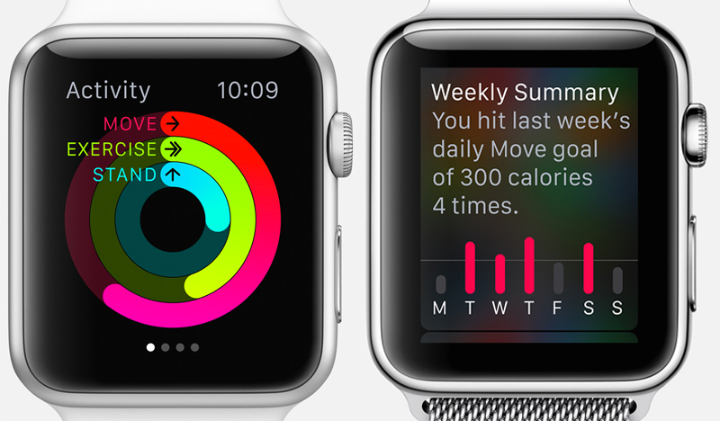

Slide 19
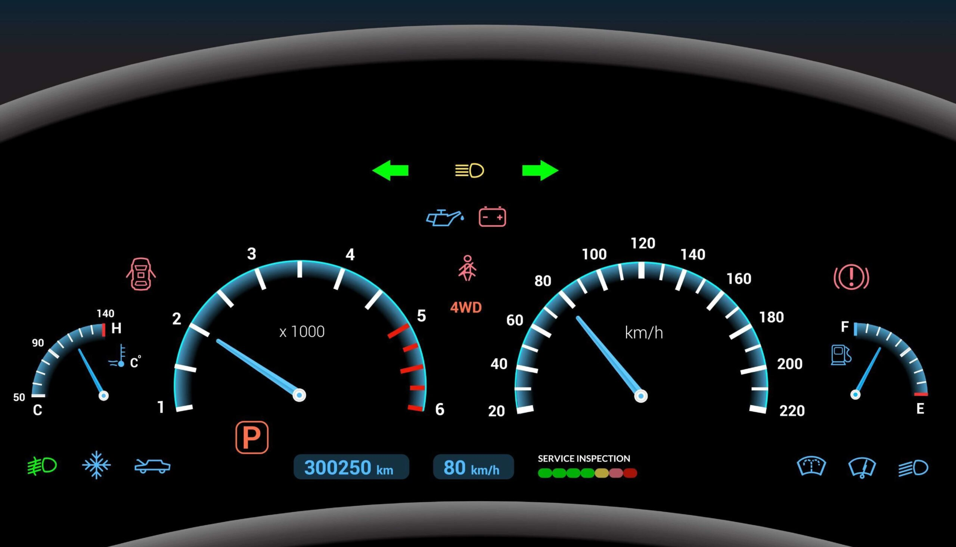

Slide 20


Slide 21
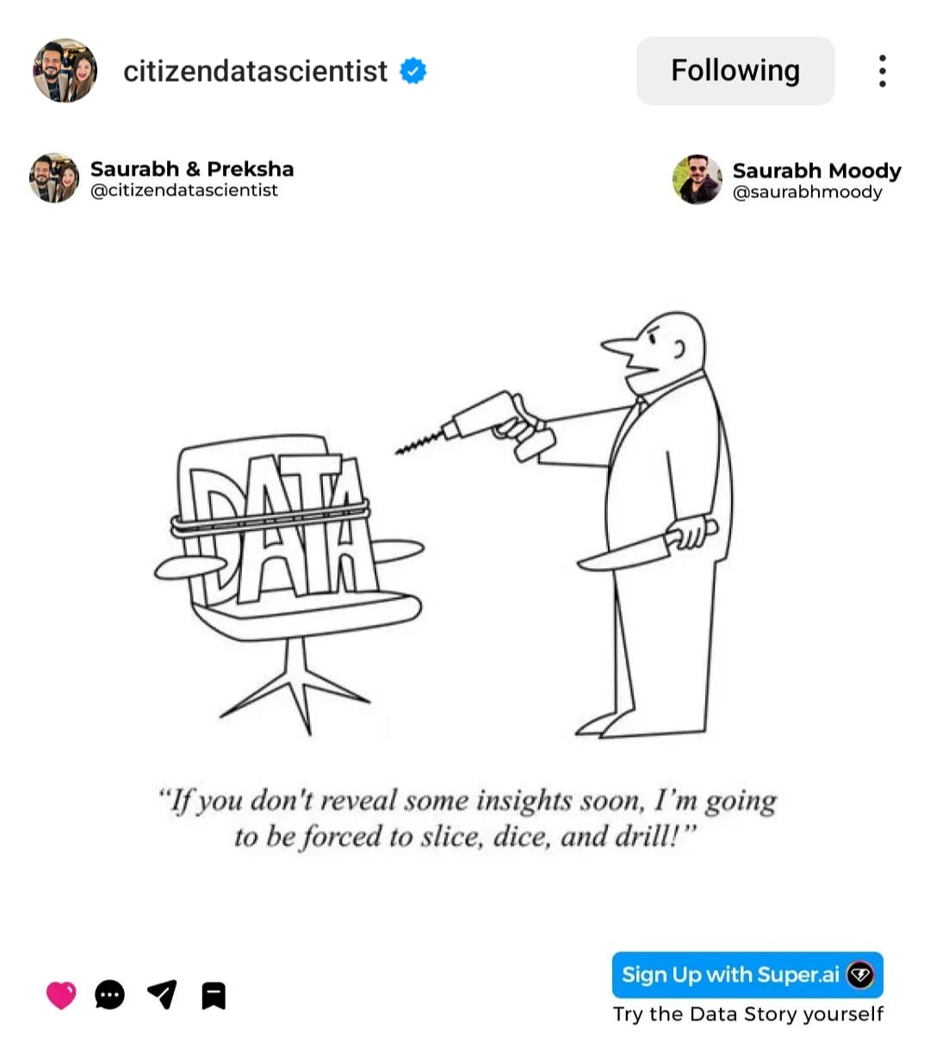
Thank You!

